Slide 1
Before you continue turn this PowerPoint into a slide show by clicking on the following icon at the bottom of your screen:
Click on the screen to move onto the next slide.

Slide 2
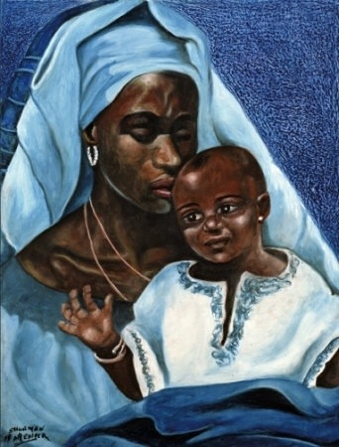
RE As this is your RE lesson you may want to start this lesson with a prayer. Hail, Holy Queen, Mother of Mercy; Hail, our life, our sweetness and our hope! To thee do we cry, poor banished children of Eve. To thee do we send up our sighs, mourning and weeping in this valley of tears! Turn, then, most gracious Advocate, thine eyes of mercy toward us, and after this, our exile, show unto us the blessed fruit of thy womb, Jesus. O clement, O loving, O sweet Virgin Mary.

Slide 3
For this lesson you will need: a book to write in and a pen or a pencil. It would be helpful if you had a bible and crayons, but don’t worry if you do not have these resources.

Slide 4
Thursday 16th July LO: To know a range of Church prayers to honour Mary the Mother of Jesus.

Slide 5
Memorare Remember, O most gracious Virgin Mary, that never was it known that any one who fled to thy protection, implored thy help or sought thy intercession, was left unaided. Inspired with this confidence, I fly unto thee, O Virgin of virgins my Mother; to thee do I come, before thee I stand, sinful and sorrowful; O Mother of thy Word Incarnate, despise not my petitions, but in thy clemency hear and answer me. Amen.

Slide 6
The Angelus V. The Angel of the Lord declared unto Mary, R. And she conceived of the Holy Spirit. Hail Mary, etc... V. Behold the handmaid of the Lord. R. Be it done unto me according to Your Word. Hail Mary, etc... V. And the Word was made flesh, R. And dwelt among us. Hail Mary, etc... V. Pray for us, O holy Mother of God. R. That we may be made worthy of the promises of Christ. Let us pray: Pour forth, we beseech You, O Lord, Your Grace into our hearts; that as we have known the incarnation of Christ, your Son by the message of an angel, so by His passion and cross we may be brought to the glory of His Resurrection. Through the same Christ, our Lord. Amen.

Slide 7
Can you answer the following questions in your book, or talk about them with someone at home?
What do we ask of Our Lady in these prayers?
Why do you think that it is important to pray these words?
Which prayer do you like the best? Why?
Which words stand out to you the most?

Slide 8
Through those prayers, including the ‘Hail Holy Queen’ prayer said at the beginning of the lesson, we are saying that we recognise that Mary has always been faithful. We understand that she has been loyal to the Lord and that she is most gracious. We are asking for help to be more like her. We understand our sinful ways and ask for her help in lifting our prayers up to God. We are asking that just as she was worthy of the promises of Christ, that we too may become worthy. We must remember that Catholic Christians do not pray to Mary but pray through her, asking her to lift their prayers up to God.

Slide 9
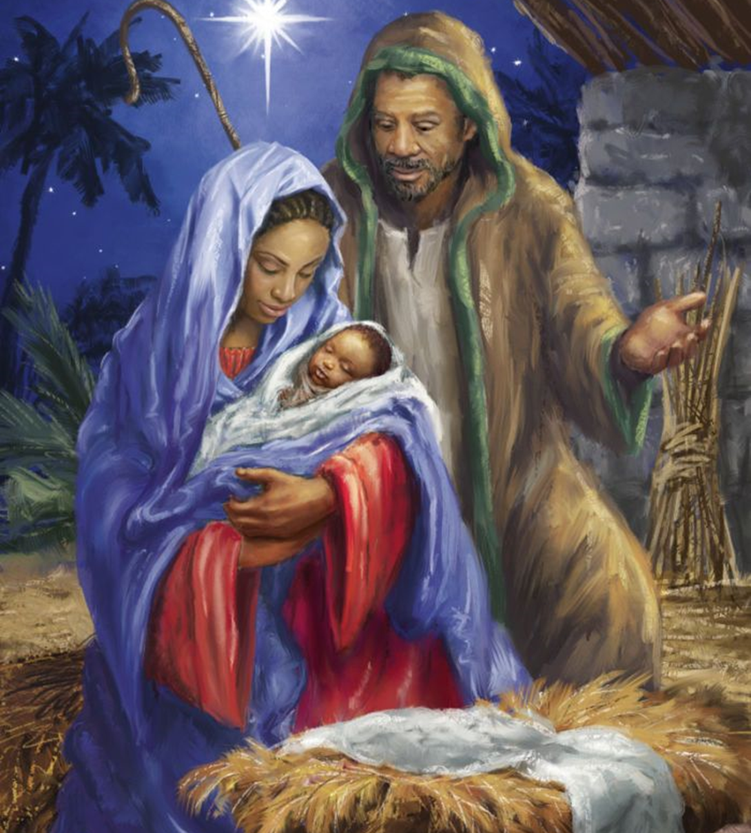
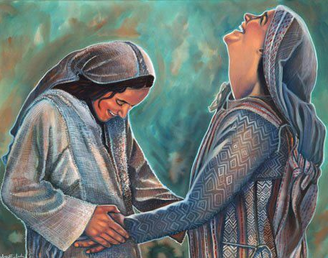
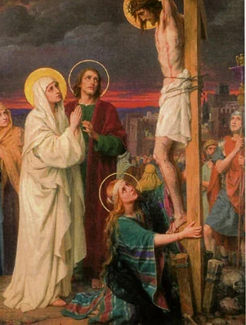
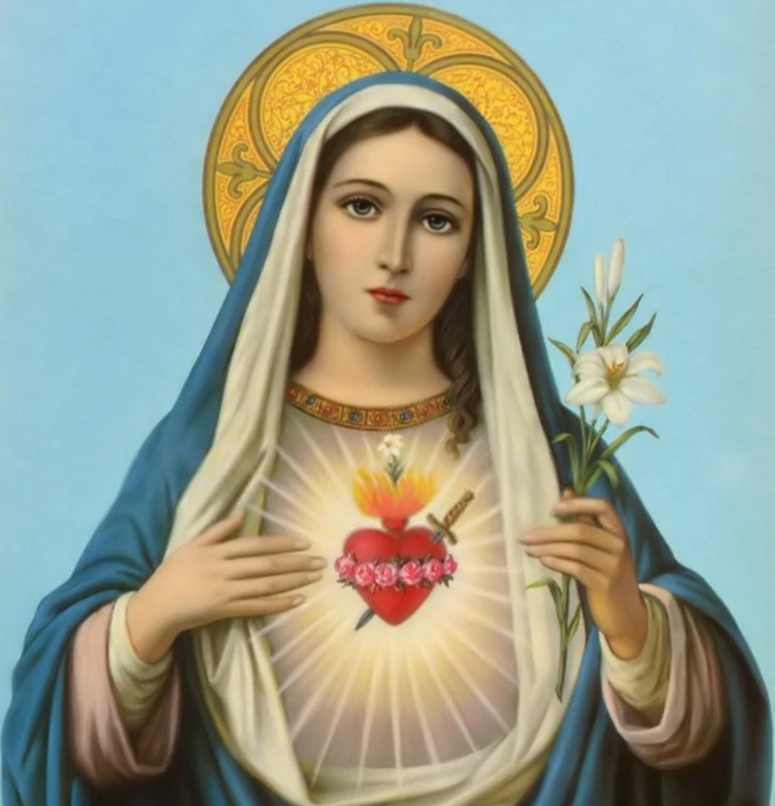
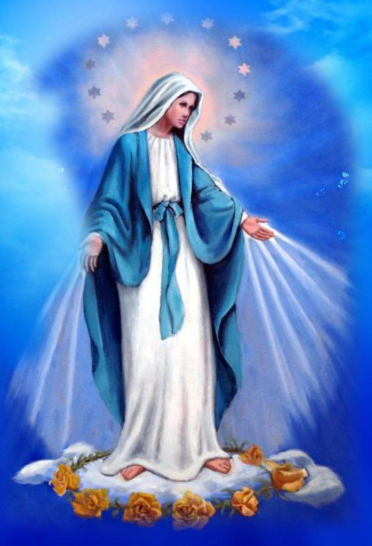
Take a look at the images of Our Lady. Which image do you like the best? What do these images tell us about Mary?

Slide 10
Your work for this lesson is to draw your own image of Mary and use the title that you created from your lesson two weeks ago, to label your picture. Write a reflection for your image; does it have a special meaning?

Slide 11
Well done! You have worked hard this lesson.

