Slide 1
Aims for the Session
•To give parents and carers practical ideas of how to support your child’s reading.
•To share helpful resources.
•To stress the importance of working together to ensure all children can read at the highest level.

Slide 2
Aims for your child
•To encourage a love of reading,
•To develop fluency and independence,
•To develop comprehension and understanding
To be able to read fluently in order to ‘read to learn.’

Slide 4
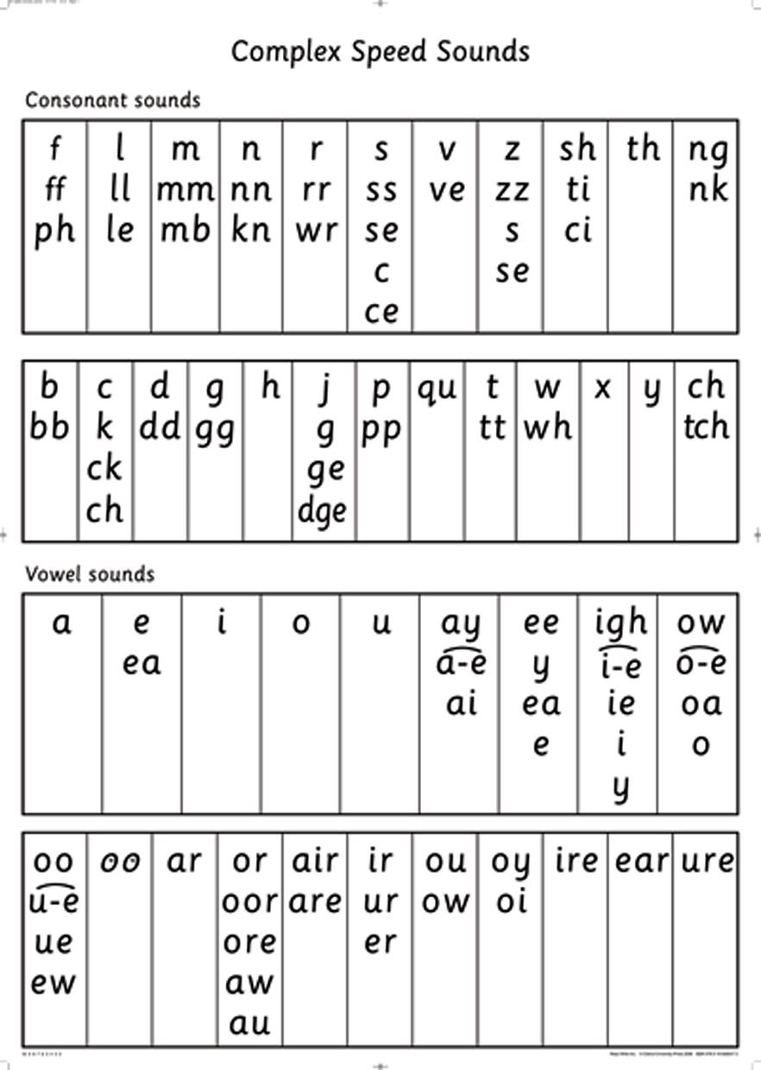
How we teach reading at Sacred Heart Catholic School
• Phonics
• Guided Understanding
• Home reading

Slide 5
The books your child brings home…
We ALL want the children experience success:
• We aim to provide books that are directly linked to phonics phases – ‘banded books’
• We aim to use a variety of schemes and text-types
• Prepare them for unfamiliar phonemes/words/

Slide 6
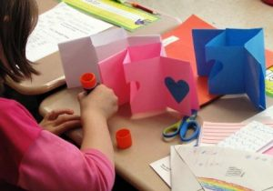
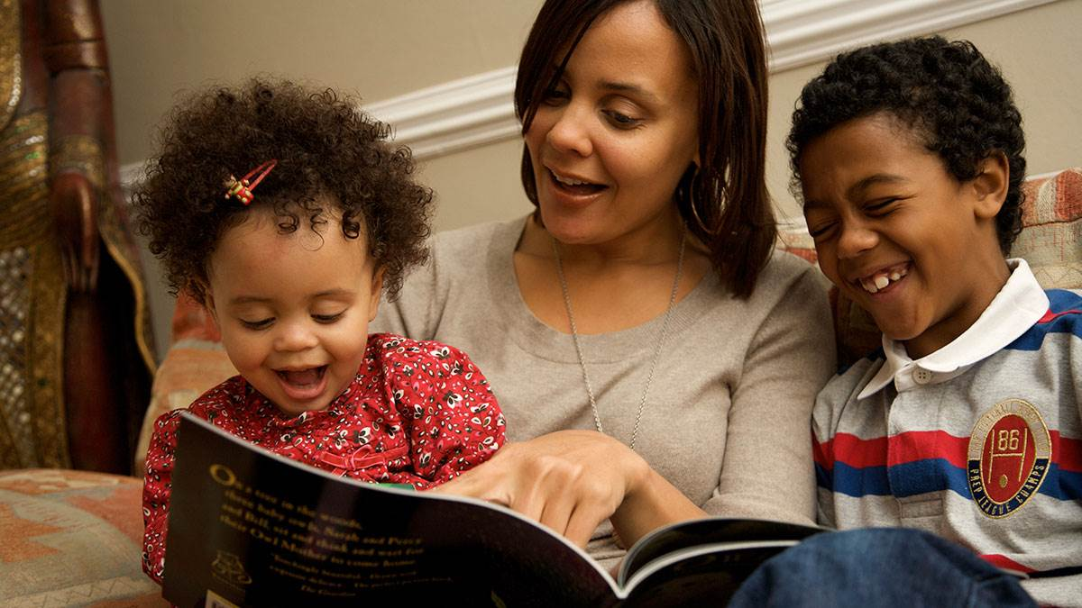
Reading at home with your child…
• Try to build this into your daily routine
Let your children see you read
Boys need to see that reading is something men do
• Have a set space you can read in
• Remember, both reading the school book and reading to your child are important.
Make your own books
Make it fun!
Talk about books.
Sit and listen - don’t do chores around the reader!
Respect choices.

Slide 7
Before Reading
If it is the first time your child has read the book, look at the cover and title with them to predict what they think the book might be about. (Do a picture walk.)

Slide 8
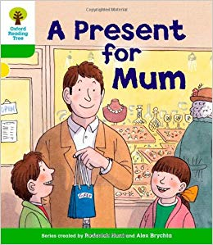

Slide 9
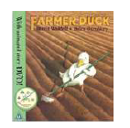
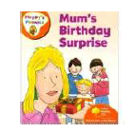
During reading
•Ask your child many questions about the characters in the book as you read the story
•Have your child use his/her finger to follow the direction of the text (top to bottom, left to right) •Have your child look at the sentences and see if he/she can find any of the sounds.
•Discuss the meaning of any unfamiliar words or words they do not understand.

Slide 10
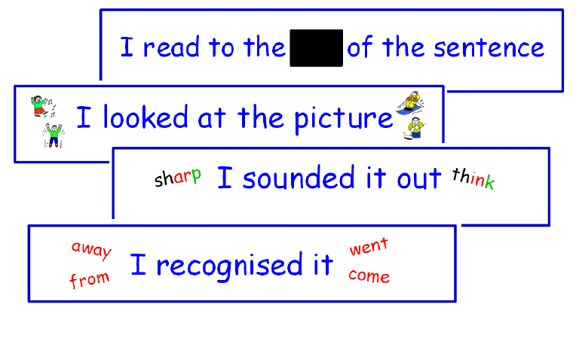
Reading strategies
Always use your own parental judgement. If your child is tired or feeling unconfident, shift the balance of reading more towards you...

Slide 11
Effective decoding
If your child loses their place when reading, use a ruler to help them with their tracking along the page.
If your child fails to recognise repeated words, try word hunting. Show them the word in isolation, talk about it, then have a word hunt. They scan through the book to find the word as many times as possible.

Slide 12
Reading for Meaning
If your child reads without expression, try ‘echo reading.’
If you are asking questions about what is written in the book, ask them,
‘Can you find the page that says that?’ or
‘Which word in the story tells you that?’
Retrieval – ‘Find it questions

Slide 13
Reading for Meaning
If you are asking questions which your child must infer from the text (the answer is not stated) can you ask them,
Why do you think that?
Can you find the word or phrase that makes you think that?
Inference – ‘Prove it questions’

Slide 14
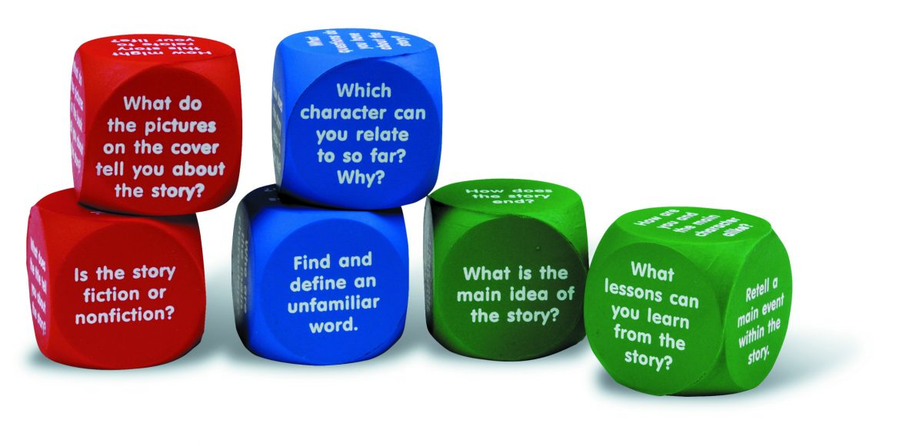
Reading for Meaning
There is always the opportunity to ask your child:
How is the character feeling at this point in the story?
Why is he/she feeling that way?
How do you know?
Sometimes children need help developing their feeling words vocabulary.

Slide 17
After reading
•Discuss with your child what they liked/disliked about the story
•Can your child think of another title for the book and why?
•Did the story have a sad or happy ending?
Can your child think of a different ending for the story?
•Can your child think of another character which he/she might want to add to the story and why??’

Slide 18
Think of something new you have learnt today about the importance of reading.
Consider one thing that you will try and do with your child this week to support their reading.
All the activities and this powerpoint will be on the school website.

