Slide 1
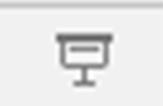
Before you continue turn this PowerPoint into a slide show by clicking on the following icon at the bottom of your screen:
Click on the screen to move onto the next slide.

Slide 2
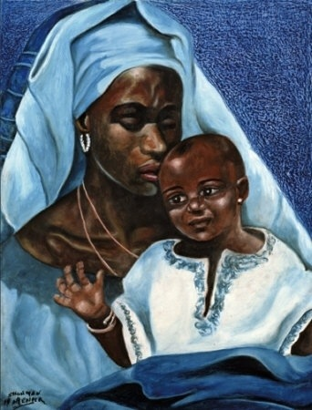
RE As this is your RE lesson you may want to start this lesson with a prayer. Hail, Holy Queen, Mother of Mercy; Hail, our life, our sweetness and our hope! To thee do we cry, poor banished children of Eve. To thee do we send up our sighs, mourning and weeping in this valley of tears! Turn, then, most gracious Advocate, thine eyes of mercy toward us, and after this, our exile, show unto us the blessed fruit of thy womb, Jesus. O clement, O loving, O sweet Virgin Mary.

Slide 3
For this lesson you will need: a book to write in and a pen or a pencil. It would be helpful if you had a bible and crayons, but don’t worry if you do not have these resources.

Slide 4
Thursday 9th July LO: To know the Catholic belief of Mary and the saints sharing the life of heaven.

Slide 5
Read from Revelation 7:2-4, in your bible or online? Remember that we read this as the book of Revelation, chapter 7, verses 2 to 4. If you are unable to find this story, click onto the next slide. Remember to say our mantra before reading the scripture: “Lord, open my heart, mind and ears to receive your Word.”

Slide 6
² And I saw another angel coming up from the east with the seal of the living God. He called out in a loud voice to the four angels to whom God had given the power to damage the earth and the sea. ³ The angel said, “Do not harm the earth, the sea, or the trees, until we mark the servants of our God with a seal on their foreheads.” ⁴ And I was told that the number of those who were marked with God's seal on their foreheads was 144,000. They were from the twelve tribes of Israel,

Slide 7
Read from Revelation 7:9-14, in your bible or online? Remember that we read this as the book of Revelation, chapter 7, verses 9 to 14. If you are unable to find this story, click onto the next slide.

Slide 8
The Enormous Crowd ⁹ After this I looked, and there was an enormous crowd—no one could count all the people! They were from every race, tribe, nation, and language, and they stood in front of the throne and of the Lamb, dressed in white robes and holding palm branches in their hands. ¹⁰ They called out in a loud voice: “Salvation comes from our God, who sits on the throne, and from the Lamb!” ¹¹ All the angels stood around the throne, the elders, and the four living creatures. Then they threw themselves face downward in front of the throne and worshiped God, ¹² saying, “Amen! Praise, glory, wisdom, thanksgiving, honor, power, and might belong to our God forever and ever! Amen!” ¹³ One of the elders asked me, “Who are these people dressed in white robes, and where do they come from?” ¹⁴ “I don't know, sir. You do,” I answered. He said to me, “These are the people who have come safely through the terrible persecution. They have washed their robes and made them white with the blood of the Lamb.

Slide 9
Read from 1 John 3:1-3, in your bible or online? Remember that we read this as the book of 1 John, chapter 3, verses 1 to 3. If you are unable to find this story, click onto the next slide.

Slide 10
Children of God 3 See how much the Father has loved us! His love is so great that we are called God's children—and so, in fact, we are. This is why the world does not know us: it has not known God. ² My dear friends, we are now God's children, but it is not yet clear what we shall become. But we know that when Christ appears, we shall be like him, because we shall see him as he really is. ³ Everyone who has this hope in Christ keeps himself pure, just as Christ is pure.

Slide 11
Can you answer the following questions in your book, or talk about them with someone at home?
From the scripture that you have read, what do you imagine heaven to look like? Or what do you think will happen when Christ comes again?
What does it mean to say, ‘They have washed their robes and made them white with the blood of the Lamb’?
In the book of Revelation, it is explained that those who will enter heaven must have a mark on their forehead, which story from the Old Testament is this similar to?

Slide 12
The scripture provides an image of heaven, that there are people there from all walks of life. They are all dressed in white and they are praising God. Those people who truly believe and those who have been persecuted because they are Christians, will enter heaven. Catholics believe that Mary and the saints share in the life of heaven and this is the hope of all who believe in Christ and his ascension into heaven. The statement that ‘they washed their robes and made them white with the blood of the Lamb’, means that believers of Christ have washed their sins away and have chosen to follow a life serving the Lord, as thanks for the sacrifice that he made on the cross. In the book of Revelation, nothing was to be harmed until everyone who believes receives a mark on their forehead. The mark is a symbol of protection and is similar to the story of Moses being told to tell the Israelites to mark the doors with the blood of a lamb, so that the Lord would know which homes to pass over when he came to punish the Egyptians.

Slide 13
Catholic Christians believe that those who have died will enter heaven when Christ comes again. We affirm this is our belief during Mass when we say the Nicene Creed. In that prayer we say ‘He will come again to judge the living and the dead’. This means that we believe that Mary and the saints have ascended into heaven. It is our belief that through our prayers, those who have died will join Christ at some point but we pray that God will shine his light upon them.

Slide 14
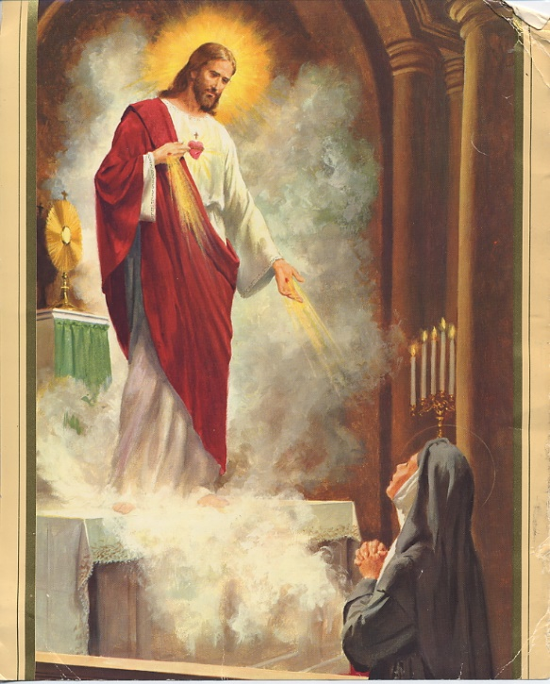
We celebrate the saints and their feast days and remember what special experiences they had of the Lord and the faith that they showed whilst living on earth. Our patron saint is Saint Margaret Mary who saw a vision of Christ. He showed her the sacred heart and she was allowed to rest her head on Jesus’ breast, as he revealed to her his passionate love for all humanity and his sorrow at the world’s indifference. Your work for this lesson is to research the feast day of Saint Margaret Mary and draw a picture of her experience of Christ. There is a picture below to help you.

Slide 15
Well done! You have worked hard this lesson.

